Slide 1
TABLE OF CONTENT
PROJECT OVERVIEW
INTRODUCTION
OBJECTIVES
DATA SET
TOOLS
DATA MAINEPULATION PROCESS
INSIGNTS
RECOMMENDED ANALYSIS
ANALYSIS REPORT

Slide 2

INTRODUCTION
VEHICLE THEFT DATA BASE BY – NEW ZEALAND POLICE DEPARTMENT

Slide 3
OBJECTIVES
This database is provided by the New Zealand police department, where they are trying to find the insight and pattern of theft so that they can understand the theft patten and take the measure accordingly also the company who is taking care of their insurance policy are also interested in analysis to create their policies much more stronger and the company who are the makers can introduce some security features.

Slide 4
PROJECT
PROJECT
Project Name
Vehicle Theft Data Base
Conducted By
ALOK D
Data Source
New Zealand Police Department
SQL PROJECT BASE ON THEFT OF VEHICLES IN COUNTRY BY POLICE DEPARTMENT TO FIND THE PATTEN ,SOURCE OF VEHICLE THEFT OCCURRING TO MAKE AN END. ITS BEEN SUPORTED BY INSURANCE COMPANY AND VEHICAL MAKERS/MANUFACTURES,

Slide 5
DATA SET
There Are Four Data Set Provided:-
stolen_vehicles.excel
Stolen_Vehicles_db_data_dictionary.excel
Make_details.excel and
Locations.excel
No_rows = 4553
No_of_columns =08
No_rows = 17
No_of_columns =03
No_rows = 138
No_of_columns =03
No_rows = 16
No_of_columns =05

Slide 6
TOOLS
SQL
SQL Server Management Studio Management Studio 19
Microsoft Excel
Microsoft Powerpoint

Slide 7
DATA MANIPULATION PROCESS
Data cleaning process.
Isnumeric function to check the data as numeric format other than that with =0 gives the non numeric data.
select * from make_details
where ISNUMERIC(make_id)=0
We used this calculation to find non numerical value.
select * from make_details
where make_id not like '[0-9][0-9][0-9]'
To convert non numerical value to numerical value we use update and alter function.
update make_details set make_id= case when isnumeric(make_id)=0 then 518
when make_id <0 then 522 else make_id end
alter table make_details
alter column make_id int
Then we found same challenge in different data set.
select *from stolen_vehicles
where ISNUMERIC(make_id)=0

Slide 8
We used this calculation To convert non numerical value to numerical(int) value we use update and alter function.(623,505,503,543)
update stolen_vehicles set make_id = case when make_id like '623%' then 623
when make_id like '505%' then 505
when make_id like '503%' then 503
when make_id like '543%' then 543 else make_id end
alter table stolen_vehicles
alter column make_id int
If there are multiple values to correct/change we can use this calculation.
update stolen_vehicles set make_id = substring(make_id,1,3) where make_id like '%[0-9][0-9][0-9]%'
Isdate function to check the data as date format other than that isdate(date_stolen)=0 gives the non date value.
select * from stolen_vehicles
where isdate(date_stolen)=0
We correct date format –yyyy-mm-dd
update stolen_vehicles set date_stolen =convert(varchar,try_convert(date,date_stolen),23) from stolen_vehicles
We update null value into date and use alter function to convert non date value into date.
update stolen_vehicles set date_stolen ='2021-10-15'
where date_stolen is null
alter table stolen_vehicles
alter column date_stolen date

Slide 9
INSIGHTS

Slide 10

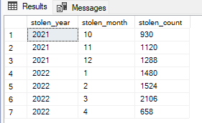
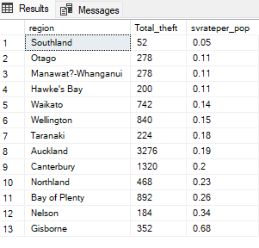
KEY Metrics
To find oldest model and latest model we use this calculation.
select min(model_year) as 'oldest_model' , max(model_year) as latest_model from stolen_vehicles
We use this query for extracting count of stolen month and stolen count.
select year(date_stolen) as stolen_year
, month(date_stolen) as stolen_month,
count(*) as stolen_count
from stolen_vehicles
group by year(date_stolen),month(date_stolen)
order by stolen_year,stolen_month
To find total theft in particular region and stolen vehicle rate per population
we use this query.
select l.region , count(sv.vehicle_id) as 'Total_theft',
round(cast(count(sv.vehicle_id) as float)/l.population *100,2) as svrateper_pop
from stolen_vehicles sv
join locations l
on sv.location_id=l.location_id
group by l.region , l.population
order by svrateper_pop , total_theft desc

Slide 11
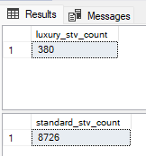
KEY Metrics
What is the count of luxury car stolen and standard car stolen?which make type vehicle is stolen more?
select count(vehicle_id) as luxury_stv_count from stolen_vehicles
where make_id in (select make_id from make_details where make_type='luxury')
select count(vehicle_id) as standard_stv_count from stolen_vehicles
where make_id in (select make_id from make_details where make_type='standard')

Slide 12
Recommended analysis
We can also say that were population is less there is noticeable count of theft by density.
select l.region , density,count(sv.vehicle_id) as 'Total_theft’,
round(cast(count(sv.vehicle_id) as float)/l.population *100,2) as svrateper_pop
from stolen_vehicles sv
join locations l
on sv.location_id=l.location_id
group by l.region , l.population,density
order by density desc
we will find the regions with the similar stolen vehicle profiles and to do so we need to create the stolen vehicle profile by make type = standard
with sv_profile as (select sv.vehicle_id,m.make_name,m.make_type,sv.make_id,sv.model_year,vehicle_type,color,
date_stolen,sv.location_id,region,population,density
from locations l
join stolen_vehicles sv
on l.location_id=sv.location_id
join make_details m
on m.make_id=sv.make_id)

Slide 13
Recommended analysis
select region, count(vehicle_id) as stolen_count,
count(distinct make_name) as un_make_name
,count(distinct color) as uni_color,
count(distinct model_year) as uni_year,
round(avg(cast(population as float)),2) as 'scaled_value_pop’,
round(avg(cast(density as float)),2) as 'scaled_val_of_density’
from sv_profile
where make_type='standard'
group by region
order by region
We will find the regions with the similar stolen vehicle profiles and to do so we need to create the stolen vehicle
profile by make type = luxury Cars.
with sv_profile as(select sv.vehicle_id,m.make_name,m.make_type,sv.make_id,sv.model_year,vehicle_type,color, date_stolen,sv.location_id,region,population,density
from locations l
join stolen_vehicles sv
on l.location_id=sv.location_id
join make_details m
on m.make_id=sv.make_id)

Slide 14
Recommended analysis
select region, count(vehicle_id) as stolen_count,
count(distinct make_name) as un_make_name
,count(distinct color) as uni_color,
count(distinct model_year) as uni_year,
round(avg(cast(population as float)),2) as 'scaled_value_pop’,
round(avg(cast(density as float)),2) as 'scaled_val_of_density’
from sv_profile
where make_type='luxury'
group by region
order by region
To find count of vehicle type this query helps as.
select vehicle_type,count(vehicle_id) from stolen_vehicles
group by vehicle_type
order by count(vehicle_id) desc
When was the vehicle stolen during which day ?day name like it was stolen on weekdays and weekend.
select*, datename(weekday,date_stolen) as 'Day_name'
from stolen_vehicles
where datename(weekday,date_stolen) not in ('saturday','sunday')

Slide 15
Recommended analysis
select*, datename(weekday,date_stolen) as 'Day_name'
from stolen_vehicles
where datename(weekday,date_stolen) in ('saturday','sunday’)
We calculate the count ,rate per population , density ,scaled value per population ,scaled value of density ,colour,years etc and considering every possible way we determine that most of the stolen vehicle was standard model, we found that most stolen vehicle type was Station wagon the family car was targeted.
Now we can say that maximum theft occur after the weekend they are happening when people are not around as per the calculations we found that Mondays, Fridays and Tuesdays the theft occurring rate is high and most of the vehicle type is station wagon, where the car used by familys for most of the time.

Slide 16
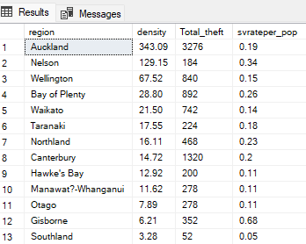
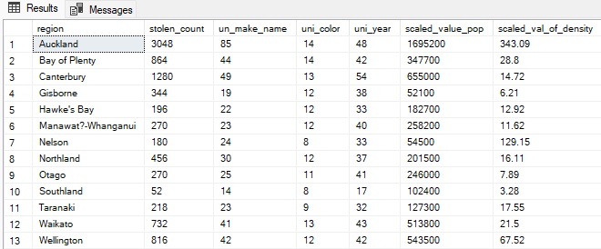
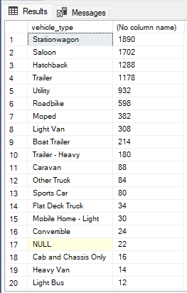
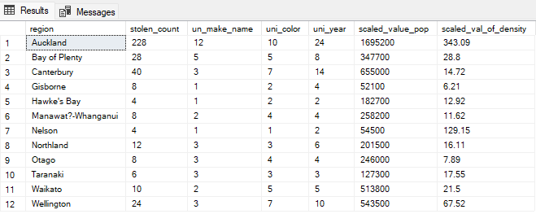

Slide 17
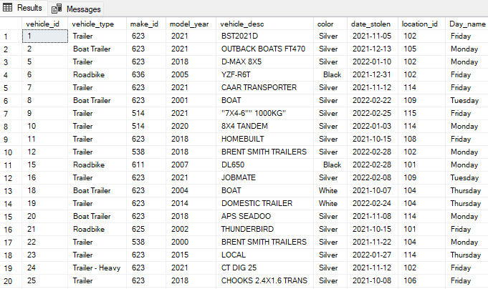
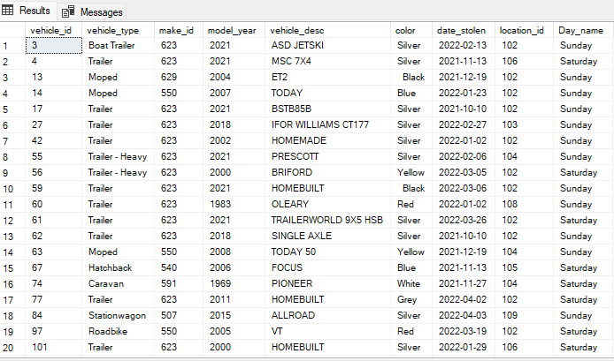

Slide 18
Are there any noticeable trends ?
Which days name most of cars were stolen?
What time vehicle got stolen is it day time , mid time and night time ? when was the owner saw the vehicle last time?
Is there any similar stolen vehicle pattens all regions? What is the possibility that same person did this vehicle theft? There are few missing data ?
Which is gender? How can we control the vehicle theft with minimum details?

Slide 19
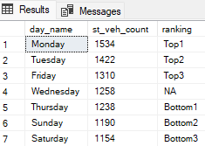
Analysis report
To find the pattern as per the days , create a report as per the stolen vehicle theft happend with the top and bottom ranking. This is the query.
with ranked_veh_profile as(
select datename(weekday, date_stolen) as 'Day_name', count(vehicle_id) as 'st_veh_count'
, rank() over(order by count(vehicle_id) desc) as 'Top_rank'
, rank() over(order by count(vehicle_id) ) as 'Bottom_rank' from stolen_vehicles
group by datename(weekday, date_stolen))
select day_name,st_veh_count, case when top_rank<=3 then 'Top' + cast(top_rank as varchar)
when bottom_rank<=3 then 'Bottom' + cast( top_rank-4 as varchar)
else 'NA' end as 'ranking'
from ranked_veh_profile
order by st_veh_count desc

Slide 20
THANK YOU

